Slide 1
L4/5 Group 4
Ripple Footie
Connor Wilby
Sam Clack
Henry Smith
Heather Bishop

Slide 2
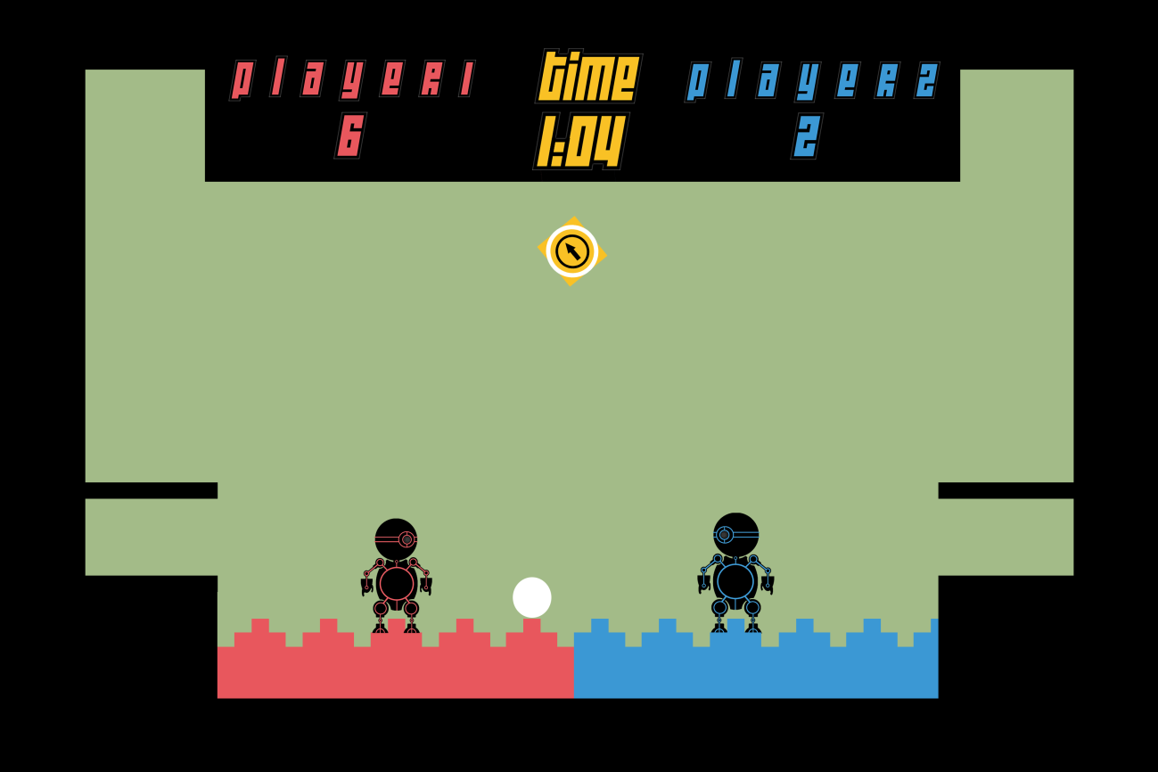
Where We Finished Last Time…
Chose the game concept that takes advantage of a wave to create physics gameplay.

Slide 3
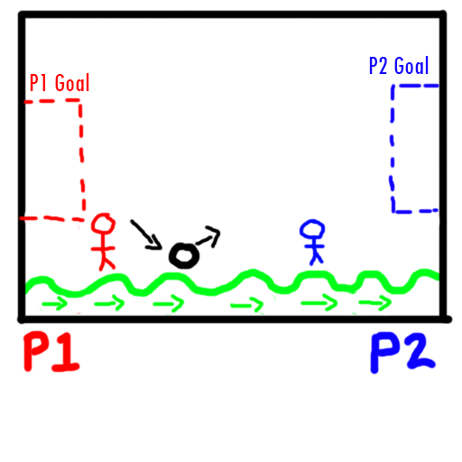
Mechanics Part 1
Two players must get a single ball into the opponents goal.
The physics comes from the bounciness of the ball, offset with the ground which is mimicking a waves behaviour.

Slide 4
Mechanics Part 2
Main mechanic is the wave generation, how fast its frequency is and how high its oscillation is.
Aimed towards evoking Hard fun. There will be challenge, but carefully tuned as to allow for a more casual and easy-going competitive experience. Laughter is a key experience for this concepts.

Slide 5
Balancing Skill vs Chance
Skill is in the precision of judging the most opportune moment to hit the ball directly or when to bounce it off the wave.
The chance comes from how the wave alters the angle in which the ball bounces.

Slide 6
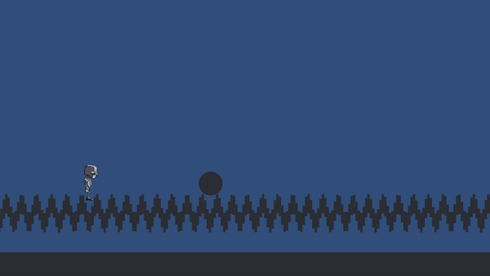
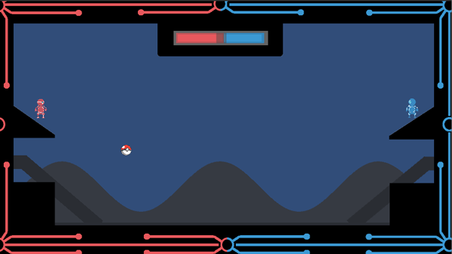
The Iterations (So Far…)
Used cubes to generate the wave. Discarded quickly due to problems with collisions that were unavoidable.
Uses fancy mathematics to generate a wave from a single object. Initial designs for the screen were also implemented.

Slide 7
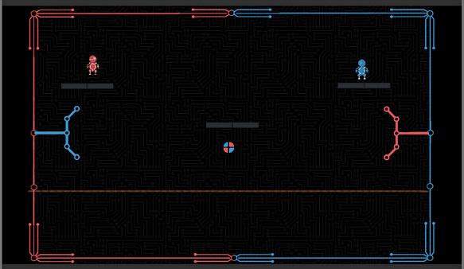
The Iterations (So Far…)
Using hinge joints to create the wave. A low cost technological and low implementation time solution.
Difficulty creating an actual wave using this method.

Slide 8
Playtesting
Playtesting results…
8 people play tested in total.

Slide 9
Playtesting
Observations
Players were not bored
Players were laughing, mocking each other and competing against each other in a friendly way.
There weren’t players winning/scoring more consistently than the other
No players gave up before the game was over.
If a player is more experienced at the game, then skill can overcome chance. This may need to be balanced in future.

Slide 10
Playtesting
Play tested both types of wave, and decided to use the maths wave as it created a better experience and allowed for a more customisable wave.

Slide 11
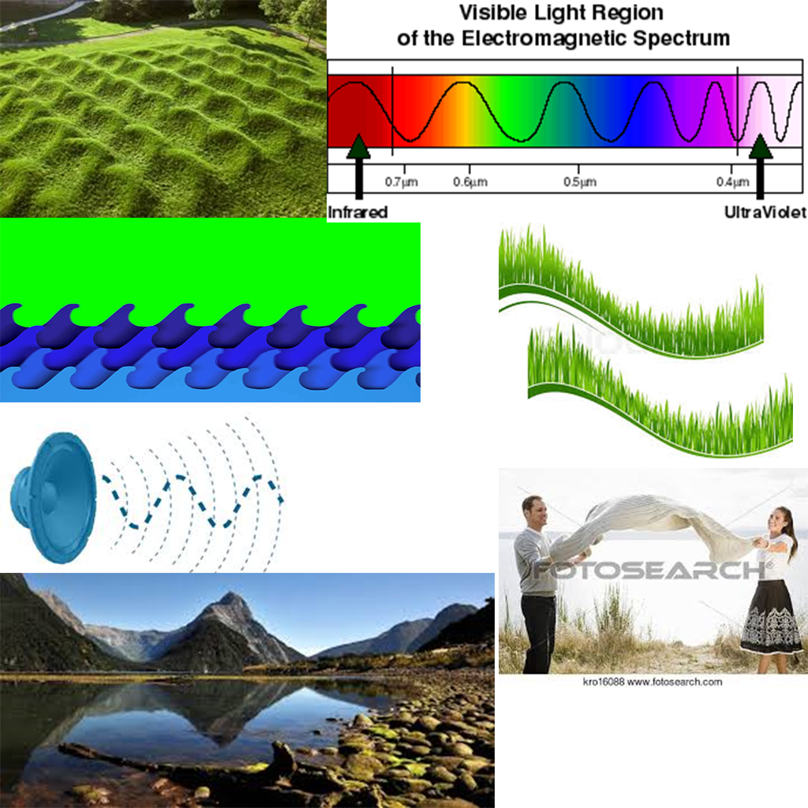
Aesthetics
Minimalistic design to keep the visual hierarchy uncluttered, for faster asset creation, and to stay within the abilities of the developers.
First step was to visualise the wave, whilst allowing for technological restrictions. (texture stretching, sprites vs materials).

Slide 12
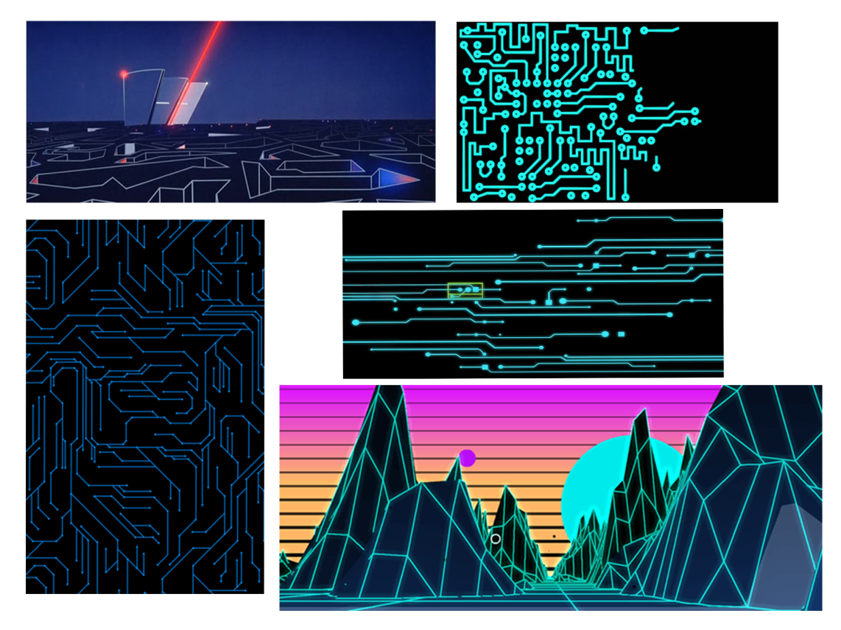
Concept Art (Vector)
Vector Graphics/Outline Style. Easy to create, easy to balance colour harmonies and to draw attention where it is required.
“Glow” effect could be challenging to accomplish well.

Slide 13
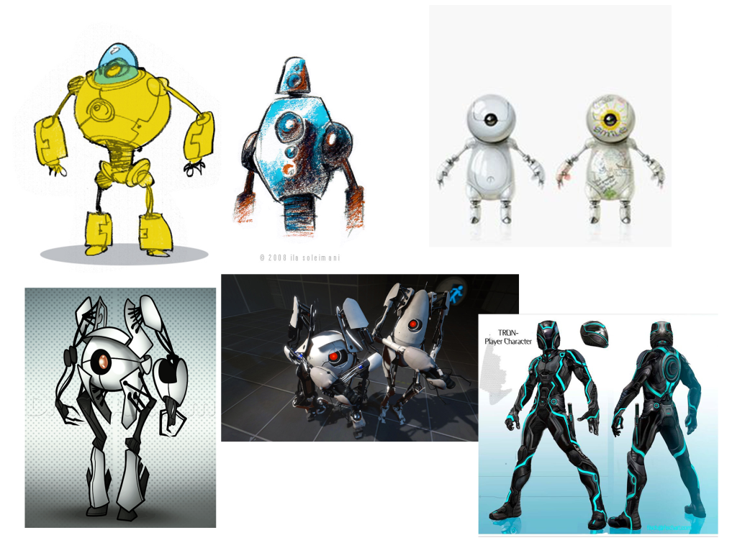
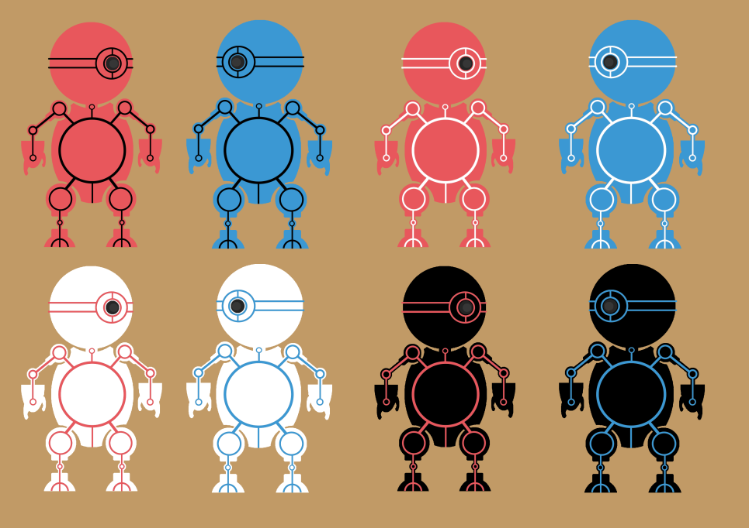
Concept Art (Vector)
Characters using rounded design to promote friendly and harmless impressions, and to steer away from intense competition between players.

Slide 14
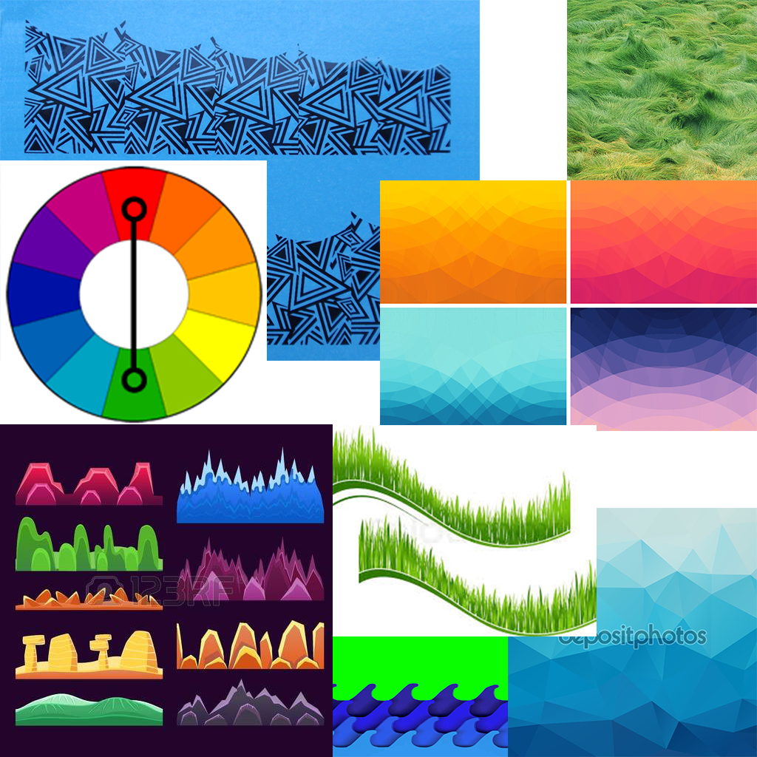
Concept Art (Geometric)
Geometric styled assets for outlines, but also tend to use monochromatic colour harmonies to keep the visual hierarchy uncluttered.

Slide 15
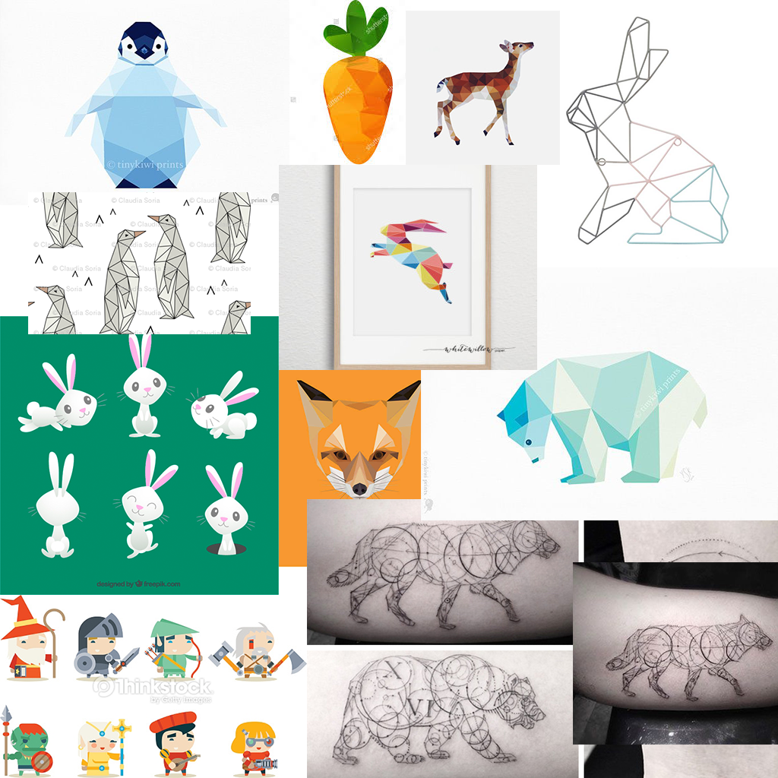
Concept Art (Geometric)
Geometric styled characters, still rounded for the friendly impression. Can offer more diversity in character designs and colour harmony's.
More time consuming to create, can be challenging to create to a high standard.

Slide 16
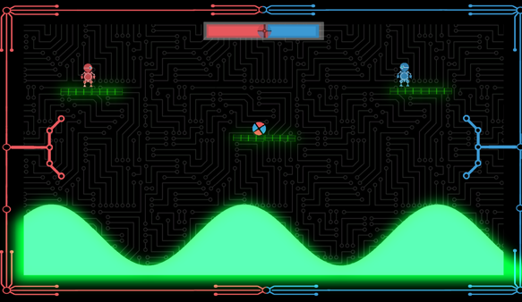
Current Iteration

Slide 17
Sprint Information
Hours Logged
Connor:
Henry:
Sam:
Heather:
Emails Sent
Connor:
Henry:
Sam:
Heather:

Slide 18
Questions?

